Slide 1




prioritizr Systematic conservation planning in R R
Jeffrey Hanson
jeffrey.hanson@uqconnect.edu.au
prioritizr.github.io/prioritizr

Slide 2

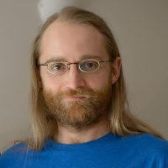
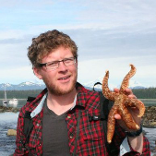
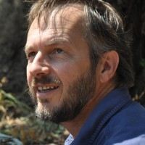
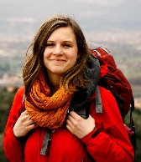
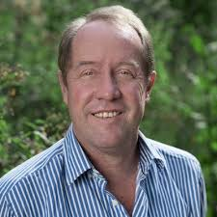
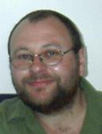
Acknowledgements
Richard Schuster
Matt Strimas-Mackey
Nina Morrell
Matt Watts
Joe Bennett
Peter Arcese
Hugh Possingham

Slide 3
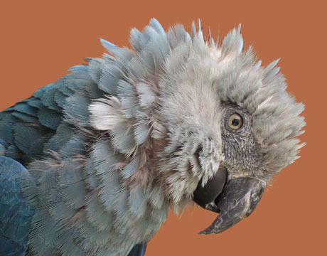
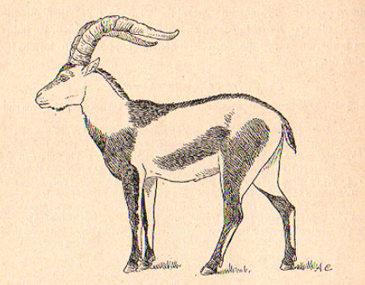
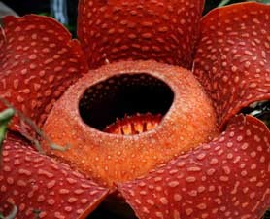
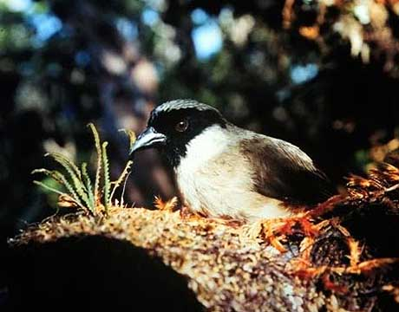
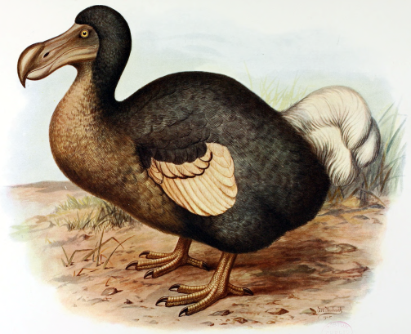
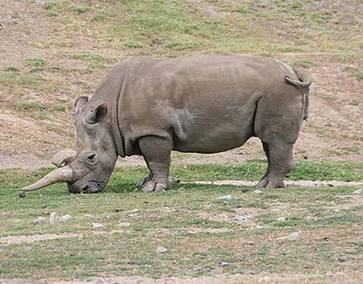
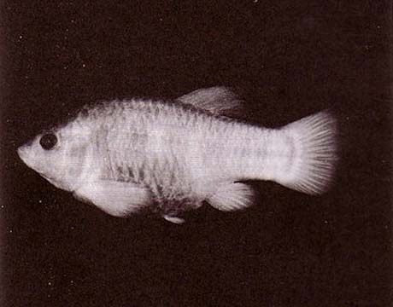
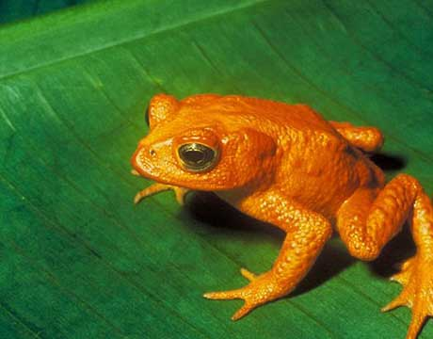
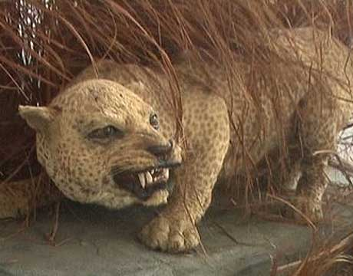
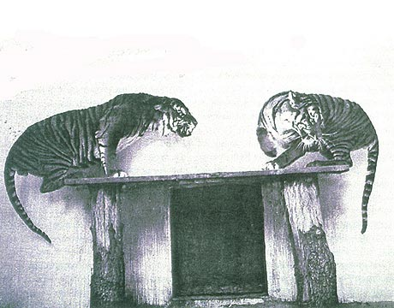
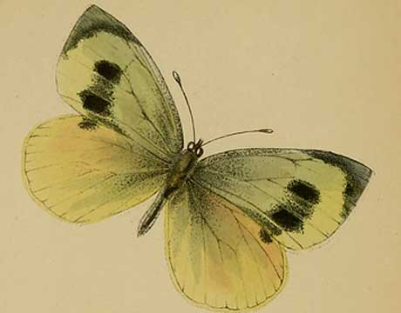
Global biodiversity crisis
Notes:
- high extinction rate
- conservation aims to maintain existing patterns of biodiversity and the processes that sustain them
- areas set aside to preserve biodiversity, and spearhead direct management actions

Slide 4
How should we
manage areas to
achieve conservation?

Slide 5

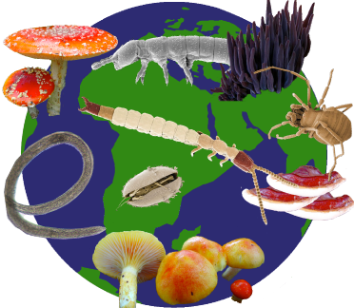
Objective
Minimize cost

Slide 6

Objective
Maximize benefit

Slide 7
Objective
Maximize benefit

Slide 8
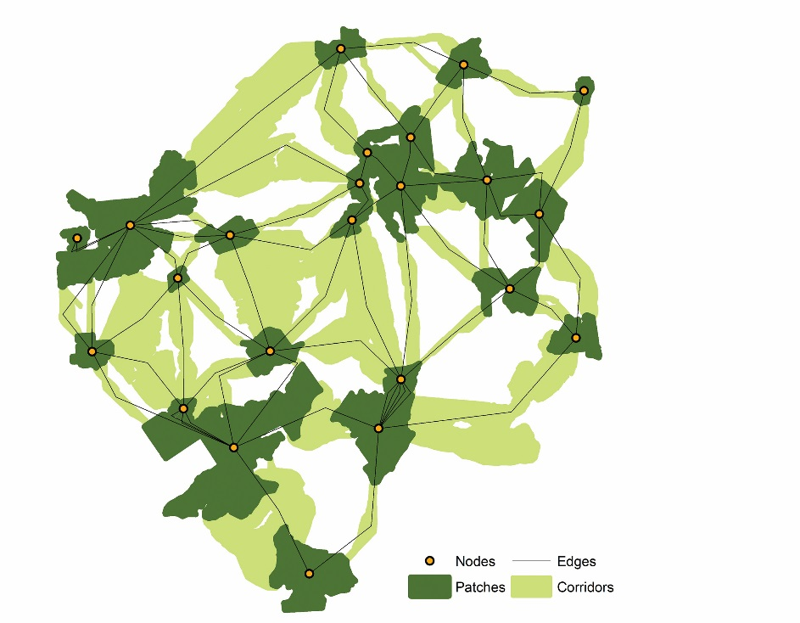
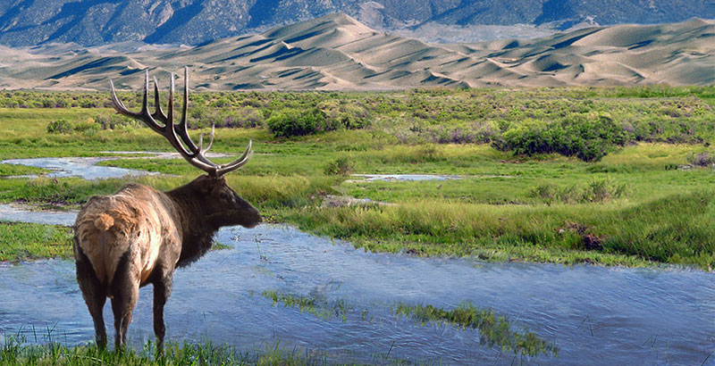
Constraints & Penalties

Slide 9
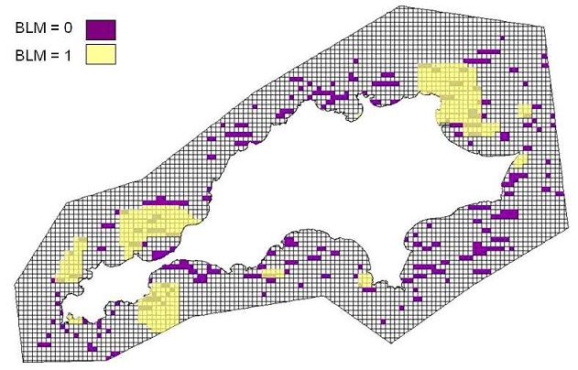
Constraints & Penalties

Slide 10
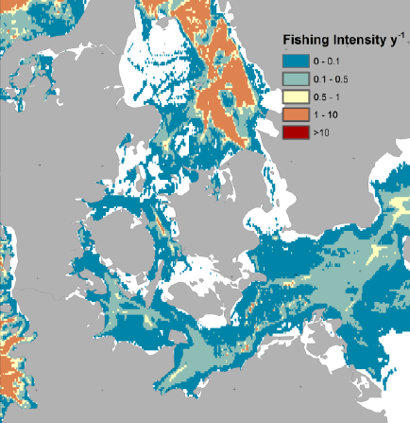
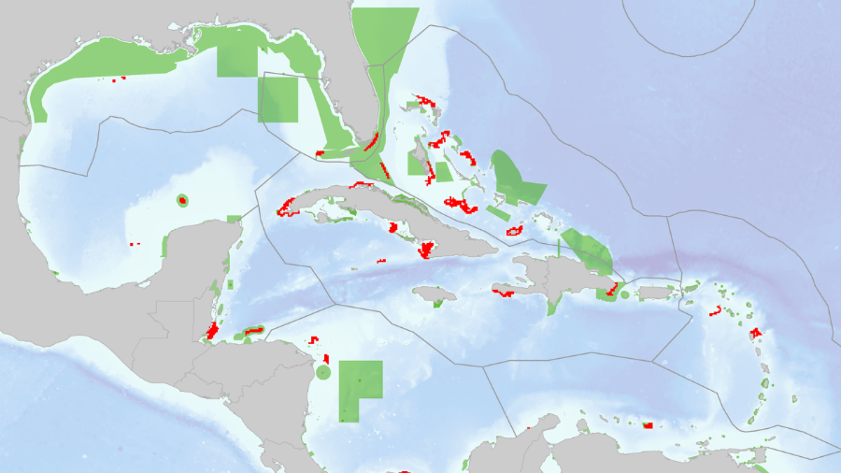
Constraints & Penalties

Slide 11
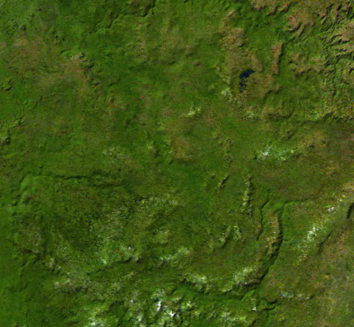
Decision type
Conserve or not?
Different amounts?
Multiple actions?

Slide 12





Solver
?
?
?
?

Slide 13

prioritizr
Human readable code
Design your problem
Solve it fast!

Slide 14
Human-readable code
Mental model
problem <- data +
objective +
constraints +
penalties +
decision type +
solver
solution <- solve(problem)

Slide 15
Human-readable code
Mental model
Code
problem <- data +
objective +
constraints +
penalties +
decision type +
solver
solution <- solve(problem)
p <- problem(areas, feats) %>%
add_min_set_objective() %>%
add_relative_targets(0.1) %>%
add_boundary_penalties(5) %>%
add_binary_decisions() %>%
add_rsymphony_solver()
solution <- solve(p)

Slide 16
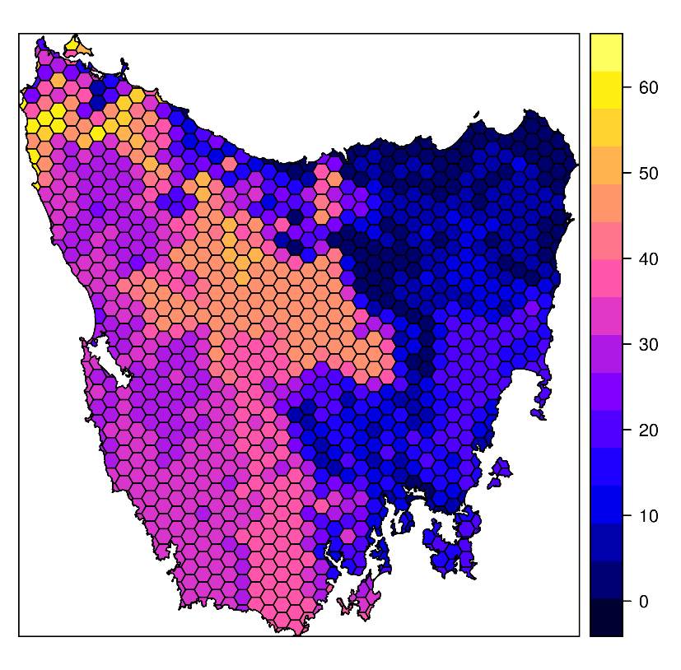
Design your problem
Study area: Tasmania, Australia
Planning units: 1130 hexagons
Features: 63 vegetation types

Slide 17
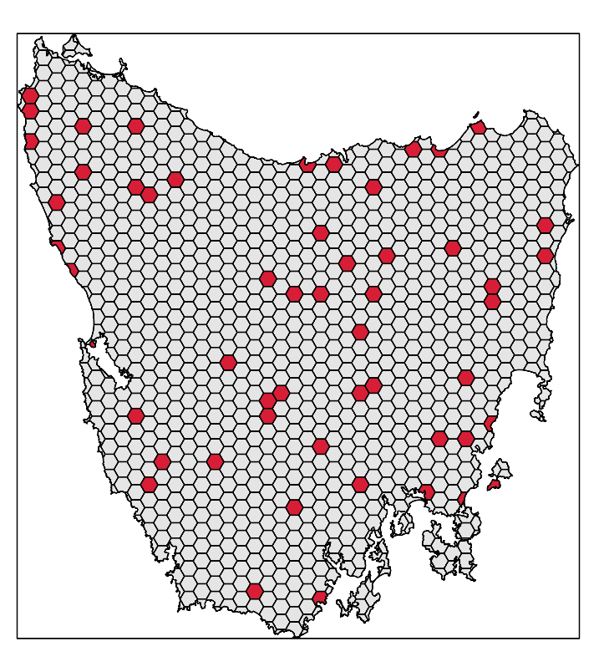
Design your problem
problem(tas_pu, tas_features,
"cost") %>%
add_min_set_objective() %>%
add_relative_targets(0.1) %>% add_binary_decisions() %>%
add_gurobi_solver(gap = 0) %>% solve()

Slide 18
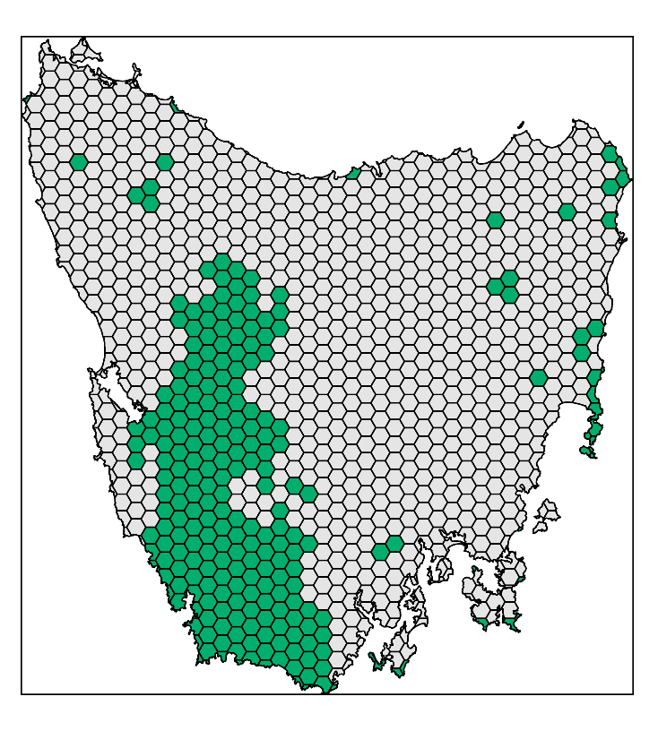
Design your problem
problem(tas_pu, tas_features,
"cost") %>%
add_min_set_objective() %>%
add_relative_targets(0.1) %>% add_locked_in_constraints("in") %>%
add_binary_decisions() %>%
add_gurobi_solver(gap = 0) %>% solve()

Slide 19
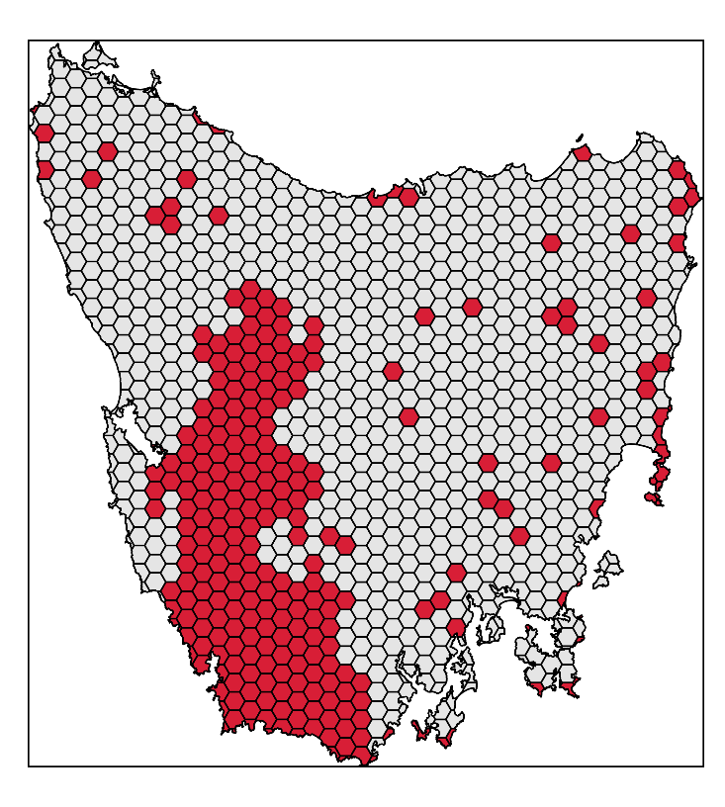
Design your problem
problem(tas_pu, tas_features,
"cost") %>%
add_min_set_objective() %>%
add_relative_targets(0.1) %>% add_locked_in_constraints("in") %>%
add_binary_decisions() %>%
add_gurobi_solver(gap = 0) %>% solve()

Slide 20
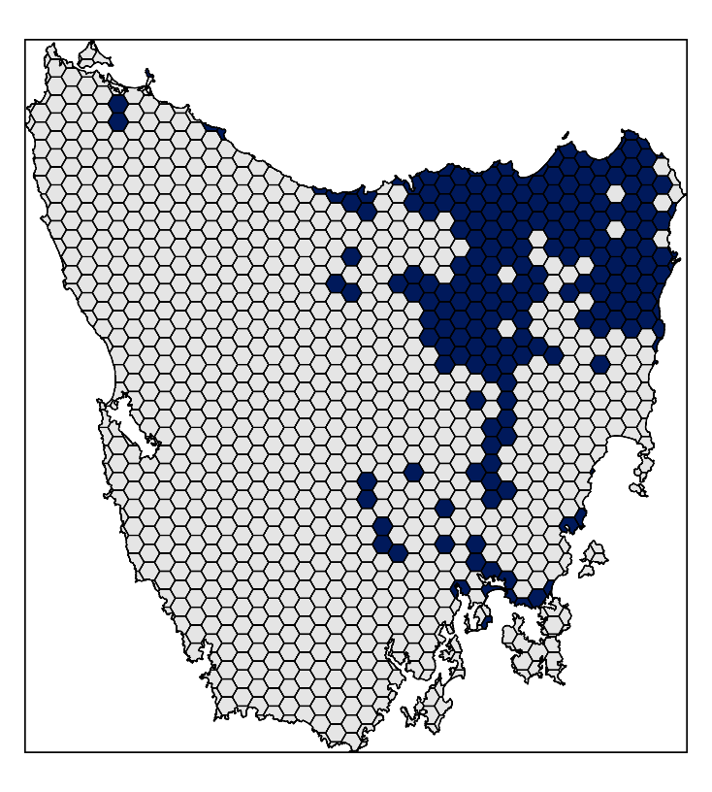
Design your problem
problem(tas_pu, tas_features,
"cost") %>%
add_min_set_objective() %>%
add_relative_targets(0.1) %>% add_locked_in_constraints("in") %>%
add_locked_out_constraints("out") %>%
add_binary_decisions() %>%
add_gurobi_solver(gap = 0) %>% solve()

Slide 21
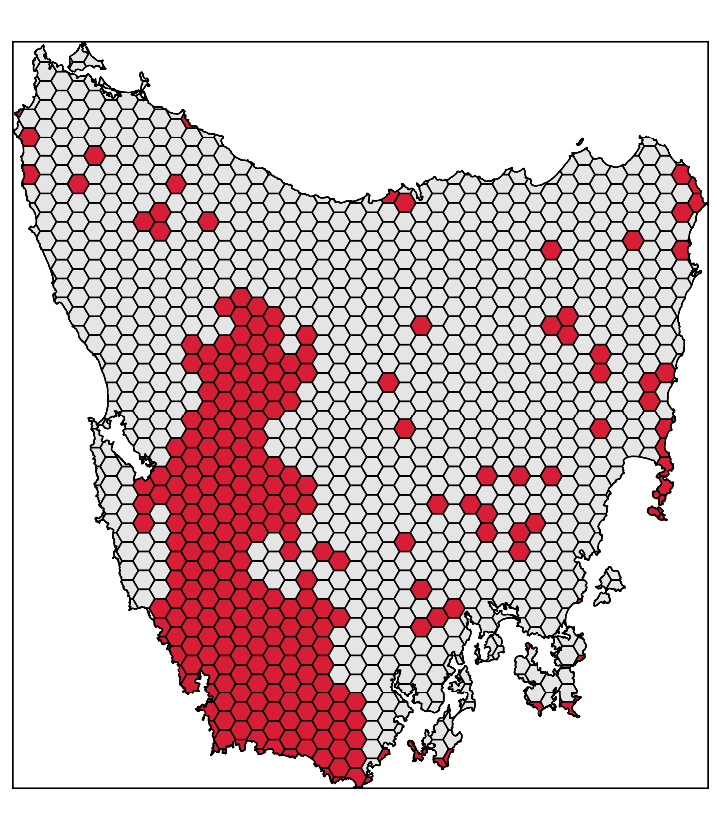
Design your problem
problem(tas_pu, tas_features,
"cost") %>%
add_min_set_objective() %>%
add_relative_targets(0.1) %>% add_locked_in_constraints("in") %>%
add_locked_out_constraints("out") %>%
add_binary_decisions() %>%
add_gurobi_solver(gap = 0) %>% solve()

Slide 22
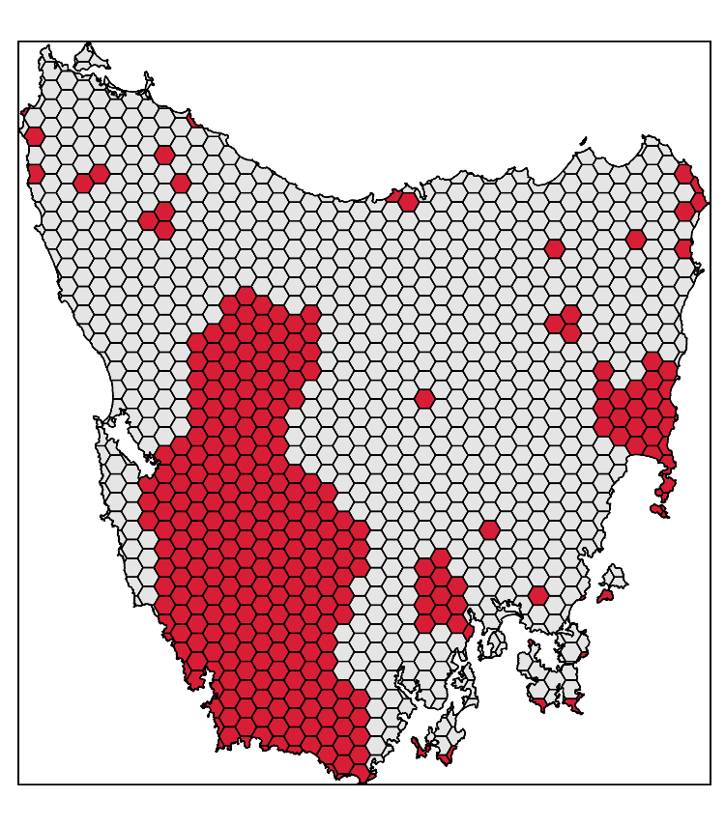
Design your problem
problem(tas_pu, tas_features,
"cost") %>%
add_min_set_objective() %>%
add_relative_targets(0.1) %>% add_locked_in_constraints("in") %>%
add_locked_out_constraints("out") %>%
add_boundary_penalties(0.01, 0.5) %>%
add_binary_decisions() %>%
add_gurobi_solver(gap = 0) %>% solve()

Slide 23
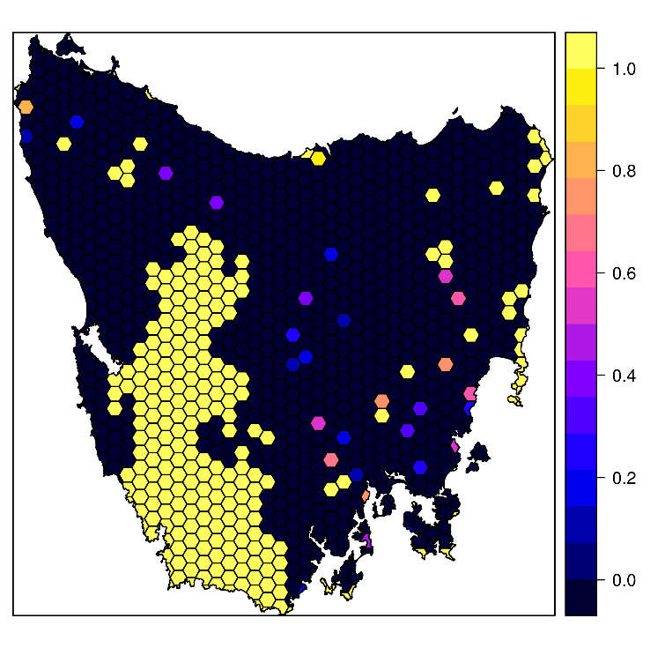
Design your problem
problem(tas_pu, tas_features,
"cost") %>%
add_min_set_objective() %>%
add_relative_targets(0.1) %>% add_locked_in_constraints("in") %>%
add_locked_out_constraints("out") %>%
add_proportion_decisions() %>%
add_gurobi_solver(gap = 0) %>% solve()

Slide 24
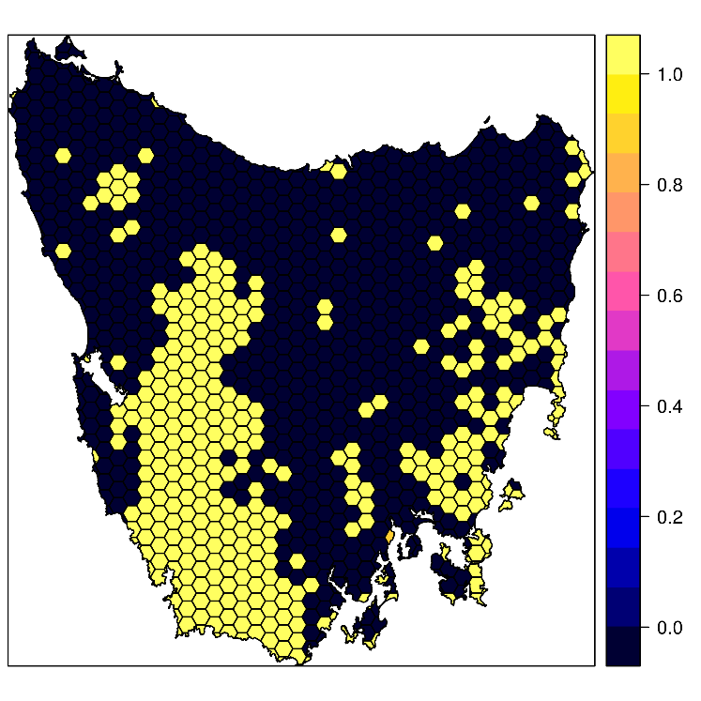
Design your problem
problem(tas_pu, tas_features,
"cost") %>%
add_max_utility_objective(budget) %>%
add_locked_in_constraints("in") %>%
add_locked_out_constraints("out") %>%
add_proportion_decisions() %>%
add_gurobi_solver(gap = 0) %>% solve()

Slide 25
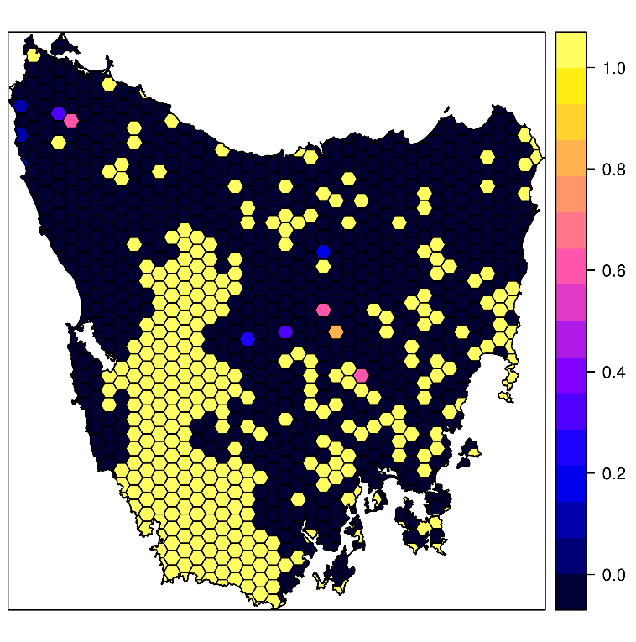
Design your problem
problem(tas_pu, tas_features,
"cost") %>%
add_max_features_objective(budget)%>%
add_relative_targets(0.1) %>% add_locked_in_constraints("in") %>%
add_locked_out_constraints("out") %>%
add_proportion_decisions() %>%
add_gurobi_solver(gap = 0) %>% solve()

Slide 26
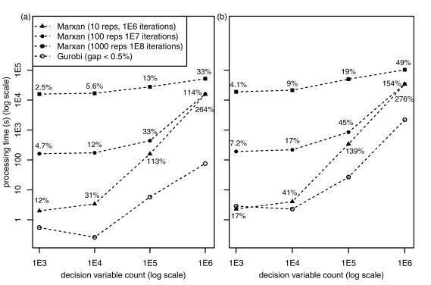
Solve it fast!
Beyer et al. (2016)

Slide 27
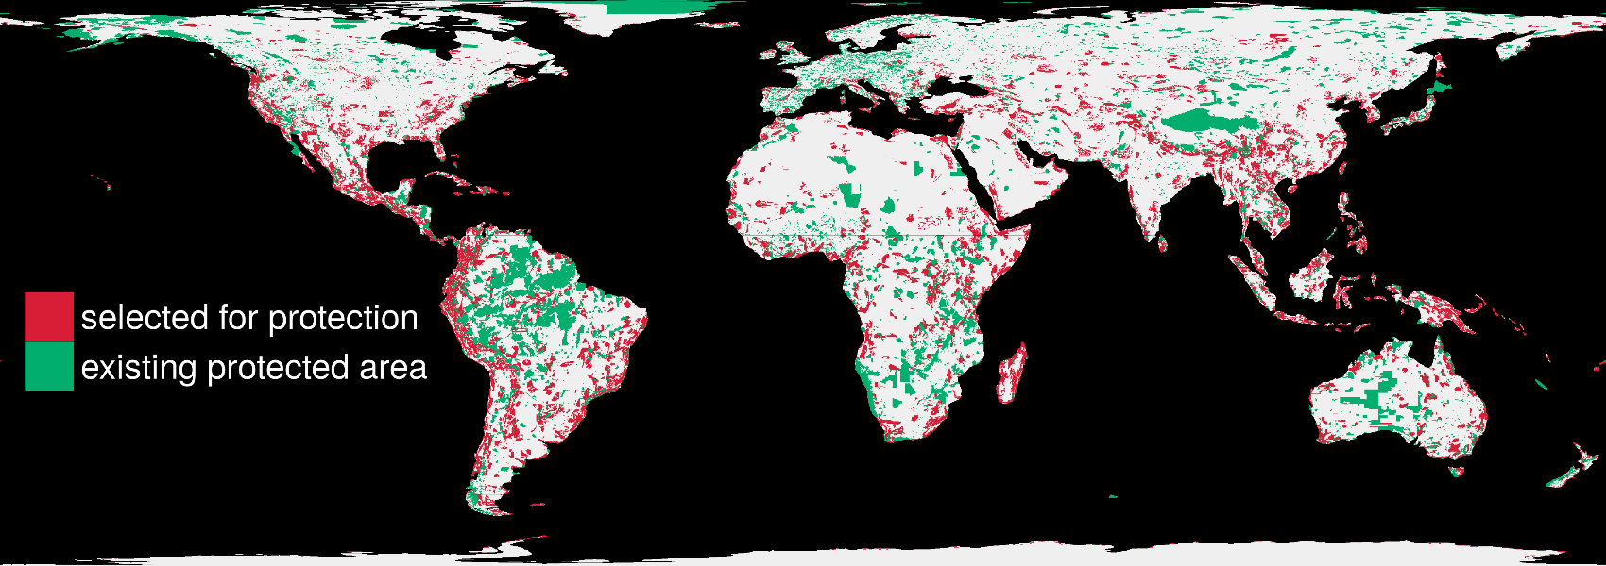
Solve it fast!
1.5 million planning units & 22,644 species: 76 minutes

Slide 28
Future work
Point-and-click interface (prioritizrshiny)
Multiple zone types (e.g. MarZone)
More objectives, constraints, and penalties!

Slide 29



jeffrey.hanson@uqconnect.edu.au
github.com/prioritizr/prioritizr
prioritizr.github.io/prioritizr

